Slide 1
Phase 2 project
King County House Sales Project
Author: Nahum Odemba
Institution: Moringa School
Instructor: Antonny Muiko
Course: Data Science
Date Submitted: October 1, 2022

Slide 2
Project overview:
For this project, I will use multiple linear
regression modeling to analyze house
sales in King County.

Slide 3
Business understanding:
Stakeholder: A house sales agency in King County
What: I will be using linear regression model to help a house sales agency in King County make better decision on house sales.
Why: The price of a house depends on many variables. I will recommend on which the most important.
How: I will build a model using linear regression where I will first understand and the prepare data accordingly for this project.

Slide 4
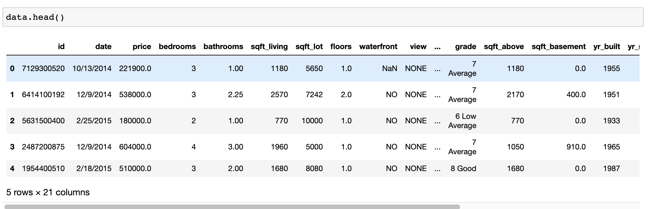
Data understanding:
The first five rows of our data looked like this:

Slide 5
Data UNDERSTANDING:
Data to be used in this project was already provided and stored in a file named kc_house_data.csv
The provided data contained 21,597 entries and 21 fields
I identified that this data contained some missing values, null values, and outliers.
Also, there were condition, waterfront, view, and grade are categorical variables.
Price is the target variable.

Slide 6
Data preparation:
I dropped columns with weak correlation with our target variable
I dropped rows with missing values
Outliers in the price column were dropped
Used one-hot encoding to transform condition and grade categorical variables

Slide 7
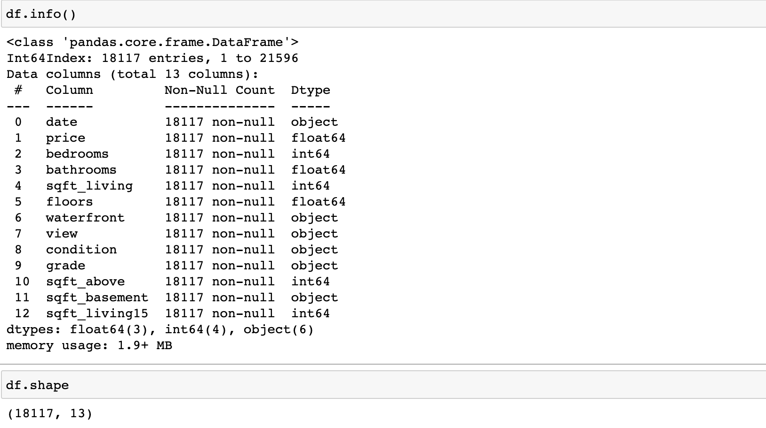
Data preparation:
At the end of data preparation, this is how our data looked like:

Slide 8
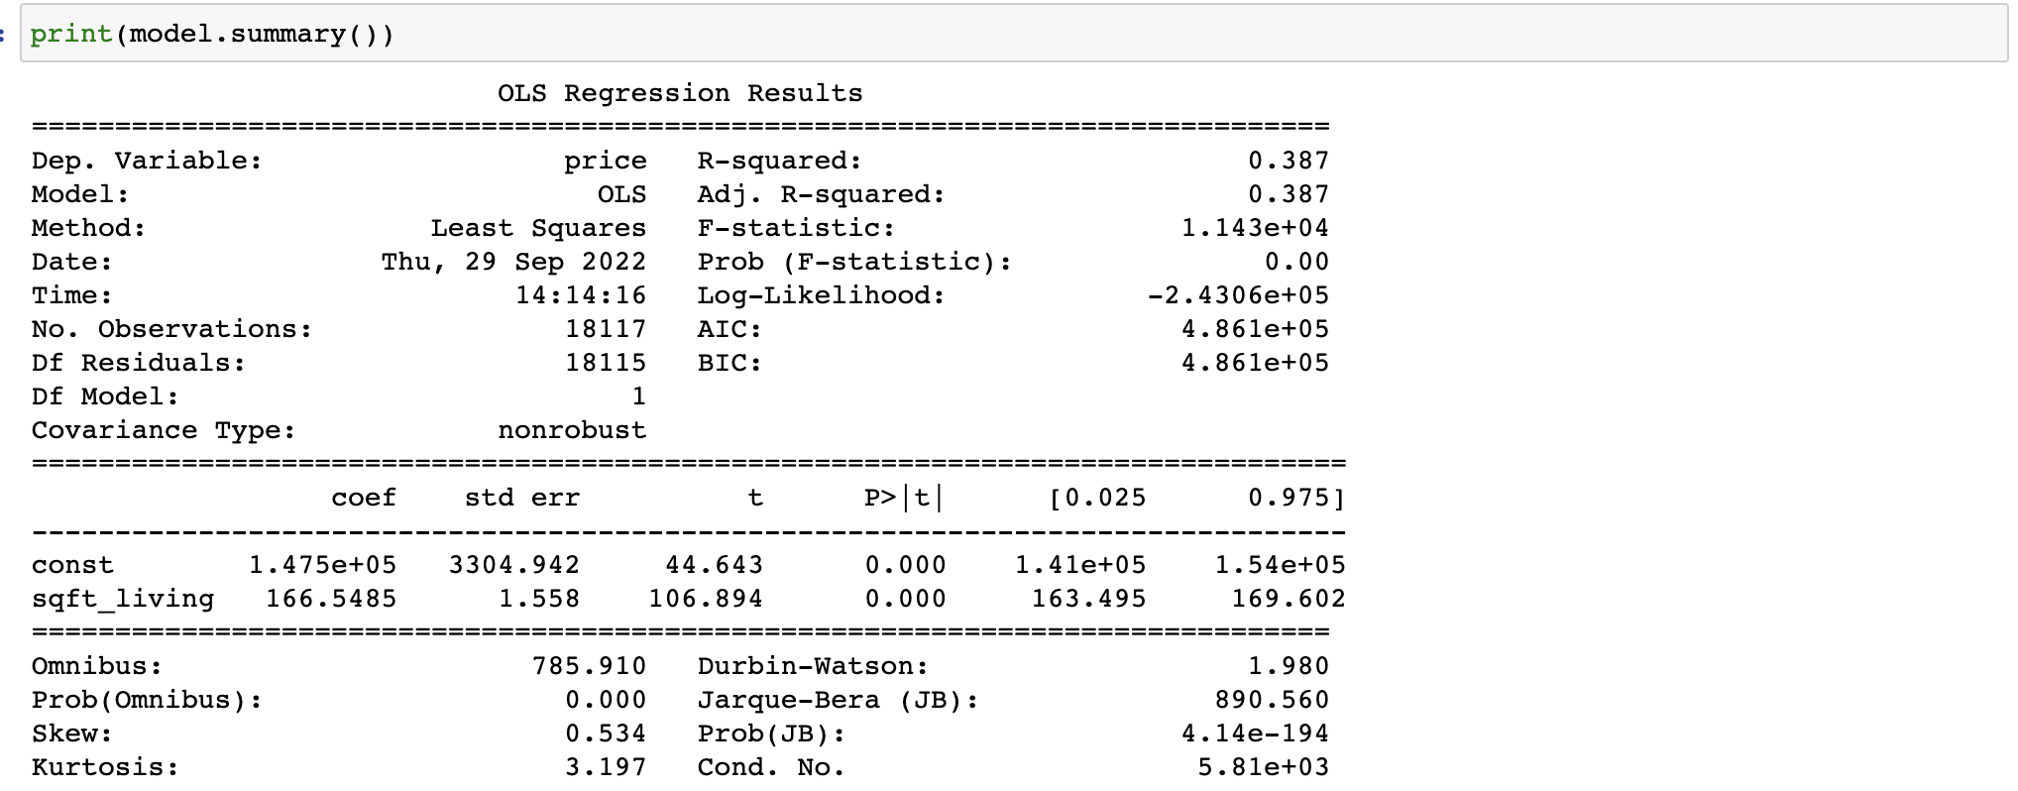
Modeling:
I started modeling using a base model which was a simple linear regression model with one dependent variable and one independent variable.

Slide 9
Modeling:
This model was statistically significant because of the p-value of 0.00 which is lower than alpha of 0.05.
Using the model, I described the formula for predicting a house price as
price = 147544.17 + 166.55 * sqft_living
However, the mean absolute error of 47425106.2057116
Was huge meaning we needed another model

Slide 10
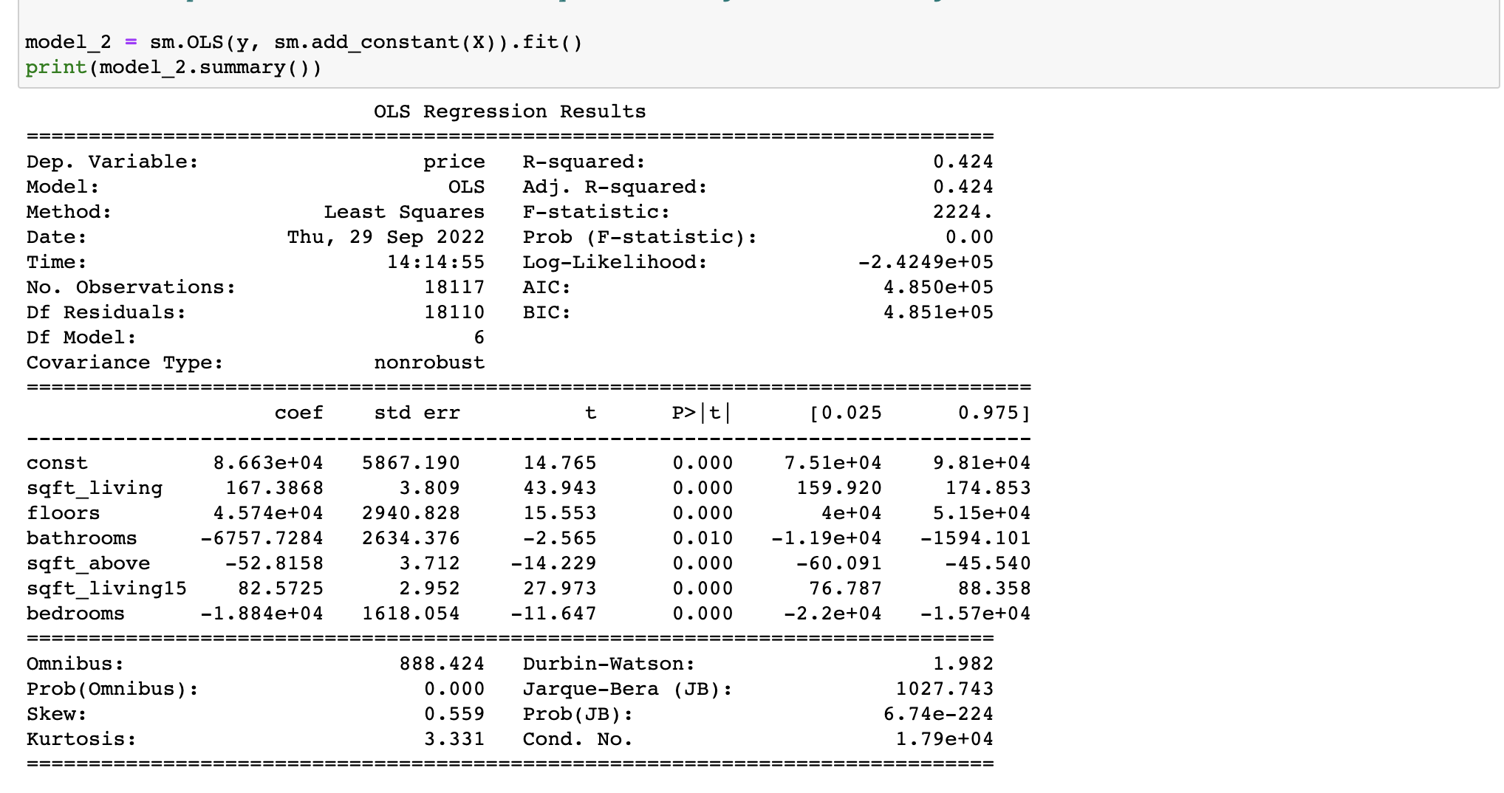
Modeling:
Multiple Linear Regression
I added more variables to my model

Slide 11
Modeling:
The p-value remained statistically significant at 0.00
The R-squared increased from 0.387 in the first model to 0.424
Also, the mean absolute error reduced to 125750.67440759364 dollars
Despite this reduction, this value meant that our model was still off with a huge value, there was a need for another model.

Slide 12
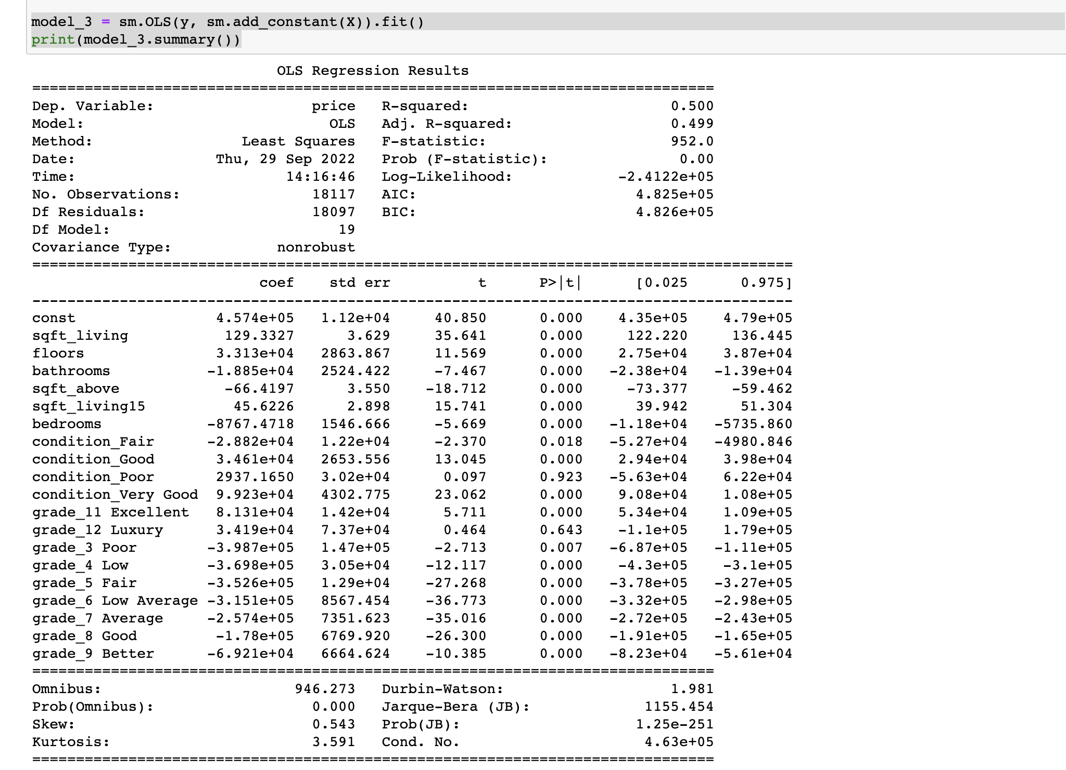
Modeling:
In this third and the last model, I added categorical data.
These were the results

Slide 13
Modeling:
The p-value for the final model remained statistically significant at 0.00
The R-squared increased to 0.500
The mean absolute error reduced to 115359.80995913423
115359.80995913423

Slide 14
Regression results:
First, all the three models had a p-value of 0.00 indicating that they were all statistically significant compared to the 𝛼=0.05α=0.05
Results show that the 𝑅2R2 value increased with the increase in variables from 0.387 in baseline model to 0.424 in model two and to 0.500 in model three.
Model Three that included the two categorical variables alongside independent variables used in model two had the highest 𝑅2R2 value of 0.500.
The mean average error kept on reducing with an increase in the variables. The third model had the lowest mean average error of 115359.81.
This means that, using the third model, our model is off by 115359.81 dollars in a given prediction.
This is slightly lower than using the first model which had an MAE of 47425106.21 dollars and second with 125750.67.
These results indicate that if our stakeholders had to use our third model to predict the price of the houses in King County, they will have to take into account the possibility of going off the mark by 115359.81 dollars.
Of course this means that our model has plenty of room for improvement to reduce this error to the minimum.

Slide 15
recommendations:
The results of this project are very interesting and useful in predicting house prices in King County.
First, it is important to know that the prices of houses in King County are affected by many variables.
Some of the variables that I found to affect the prices of the house most include the grade of the house:
Houses that are graded Poor lower the prices of houses in King County by 398715.51 dollars.
On the positive side, however, houses with condition--Very Good lead to an increase in the price of houses in King County by 99229.36 dollars.

Slide 16
RECOMMENDATIONS:
Also, though sqft_living has the strongest positive correlation with our target price, an increase in this variable by one foot leads to an increase in the house price by only 129.33 dollars.
This means that it is true that correlation is not causation.
Therefore, when predicting the price of houses in King County, you should give more emphasis on the grade and condition of the house because they are the ones with the largest impacts on the price.
Houses that should sell higher are those with conditions very good and above, have two floors and above, and with big sqft_living.

Slide 17
NEXT STEP
It is important to note that our model is not 100% accurate.
This is because of the many assumptions that were made during building the models such as the linearity between the models.
One of next steps to improve on the accuracy of the model is do more research on factors that affect house prices in the county because we had very few categorical variables to deal with.

Slide 18
END
THANK YOU FOR STAYING ALL THE WAY TO THIS LAST SLIDE

